Slide 1
Building Capacity: Lessons from the Striving Reader Grant

Slide 2
Agenda
Introduction
Explaining my role in the Striving Reader Grants
Understanding Successful Professional Development
Looking at examples from Striving Readers
Planning to implement consistent literacy practices

Slide 3
The Striving Reader Grant
Being part of a grant cohort
Summer or Winter Institutes
Funds for on-site trainings
Funds for curricular materials
Funds for other follow-up support
Site-Based PD
Observations and walkthroughs
Curriculum Design Support

Slide 4
Understanding Striving Readers
Increase research-supported literacy practices
Elementary
Secondary
Improve reading scores across the state

Slide 5
Who am I?
Teacher, Coach, Adjunct, Consultant
12 years in a Title I high school
Part of the pilot team that was part of Cracking the Common Core

Slide 6
Who am I?
Over the past 5 years, I have been providing professional development for schools in GA as part of Striving Readers

Slide 7
Who am I?
This PD has ranged from single day visits, curricular design, or ongoing support

Slide 8
The Striving Reader Grant
I generally offered sessions about certain literacy practices
PALS
Reciprocal Teaching
SRSD Writing
I’m a practitioner, so I could show teachers how these strategies work in a real classroom.
I would often model IN a classroom if students were available

Slide 9
Varying Degrees of Success
First, it is helpful do define success for PD
Successful implementation of the training into curricular decision-making
Student Growth in the desired metric
Different districts had different goals, but the most successful schools by both metrics had something in common

Slide 10
Understanding Professional Development

Slide 11
A question…
How many separate initiatives has your school or district undergone in the last five years?
A.) >2
B.)2-3
C.)3<
D.)I’ve really stopped counting.

Slide 12
A follow up question…
What percentage of the initiatives attempted have been fully, consistently implemented?
A.) >25%
B.) >50%
C.) >75%
D.) All our initiatives are perfect! What are you implying?!

Slide 13
Our school was no different
Initiatives attempted:
SBG
Class Meetings
Various purchased curricula
LFS
PBL
PGC
RTI
PLC
CCSS
Split college design

Slide 14
Why do so so many initiatives fail?

Slide 15
The problems with traditional PD
Limited time
Leads to one-and-done sessions
Monitoring actual engagement
Evaluating success
Ensuring it training translates into practice
Handling push-back

Slide 16
I’m going to recommend two titles right here

Slide 17
According to Zepeda*: Well designed PD
Extends over time
Has planned follow-up
Is job-embedded
Promotes reflection and inquiry
Includes multiple modalities
Is site-based and includes teachers from the same grade level and subject area
Is based on student performance data
*These points are all attributed to numerous other researchers, but she succinctly organizes it in her text.

Slide 18
Our literacy initiative, however, took root
For the first time, we had a comprehensive plan and the structures in place to follow through.
A comprehensive plan brought order to some of our other initiatives

Slide 19
The major difference
was how we handled the professional development
Had a clear focus
Established a pilot team
Gathered evidence
Creating a coach role
Designing a comprehensive plan for engaging staff
Analyzing data
Teacher
Student
Had follow-up training
Embedded professional development with curricular development
Allocated and protected time

Slide 20
The most successful GA schools did the following
Had a clear focus
Chose a manageable scope
Gathered evidence
Leveraged a coach role
Designed long-term plan for developing staff
Analyzed data
Teacher
Student
Had follow-up training
Embedded professional development within curricular development
Allocated and protected time

Slide 21
Let’s Take A Minute
Look at your grant documents
How many of these characteristics do you see?

Slide 22
We are here because we want two things:
To improve teacher literacy practices through professional development
To increase the reading abilities of our students
As measured by classroom performance
As measured by assessments

Slide 23
Picking a Scope
A Single Strategy
A Single Team
Choosing one literacy element to implement well
An intervention period using a single reading strategy
A single strategy to implement across content areas
Choosing the group of people to work on a number of strategies
Cross curricular teams using literacy strategies
A single grade level

Slide 24
According to Zepeda*: Well designed PD
Extends over time
Has planned follow-up
Is job-embedded
Promotes reflection and inquiry
Includes multiple modalities
Is site-based and includes teachers from the same grade level and subject area
Is based on student performance data
*These points are all attributed to numerous other researchers, but she succinctly organizes it in her text.

Slide 25
Several Schools/Districts initially chose a single strategy
Colquitt
Created an intervention period using PALS
Trained the entire staff to engage in this practice
Focused on one school at a time
Celebrated student growth

Slide 26
A Single Team
Worked to fully implement the literacy strategies that we learned from Dr. Wapole, Dr. Lewis, and Dr. McKenna
Small group of self-critical teachers
Worked through the “kinks” quietly

Slide 27
The pilot team addressed a few major problems with PD
The teachers were all willing to experiment with a proven strategy until it worked
The successes were with “our kids”
The evidence gathered became a resource for school wide roll-out
We ended up with four content area “experts”

Slide 28
Do you have time for a pilot team?
Let’s take a minute and identify which teachers would be suitable for the job
Qualities:
Strong classroom managers
Open to changing practices
Self-Reflective
Aren’t overly ambitious

Slide 29
What is your scope?
A single strategy at a time
A single team at a time
Choosing one literacy element to implement well
An intervention period using a single reading strategy
A single strategy to implement across content areas
Choosing the group of people to work on a number of strategies
Cross Curricular teams using literacy strategies
A single grade level

Slide 30
Consider Your Resources For Growth
Web Modules
Book Studies
External consultants
In-state educators

Slide 31
According to Zepeda*: Well designed PD
Extends over time
Has planned follow-up
Is job-embedded
Promotes reflection and inquiry
Includes multiple modalities
Is site-based and includes teachers from the same grade level and subject area
Is based on student performance data
*These points are all attributed to numerous other researchers, but she succinctly organizes it in her text.

Slide 32
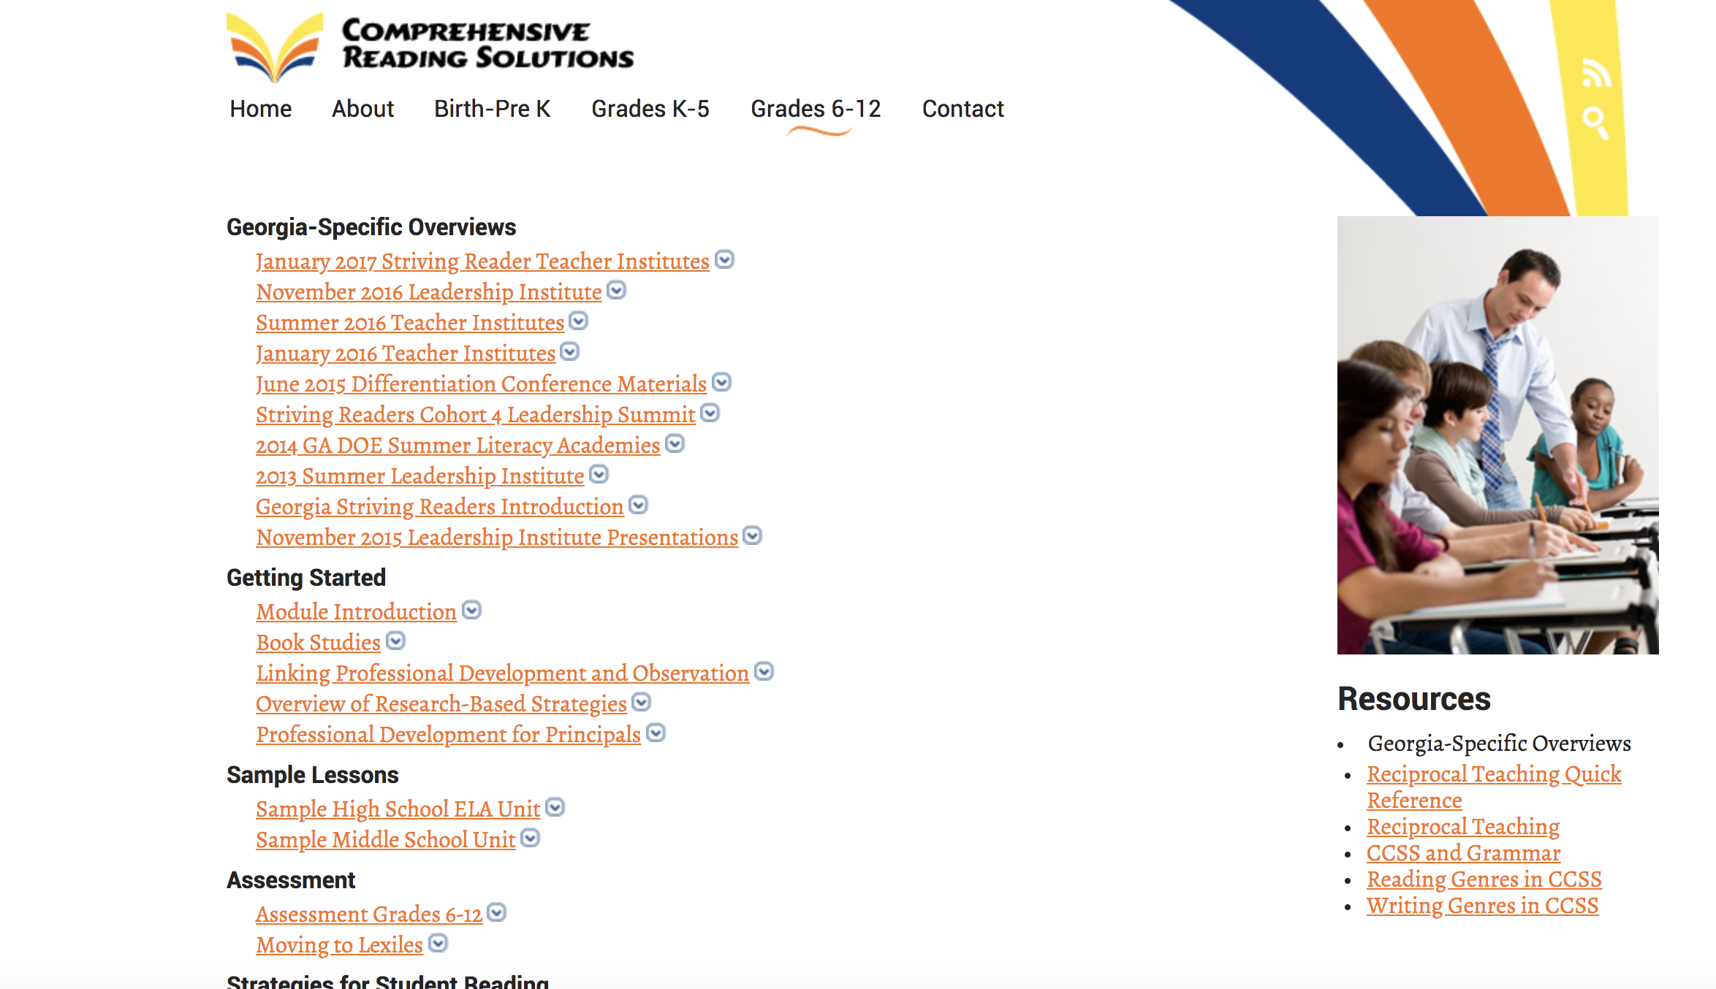

Slide 33
Book Study: Cracking the Common Core
Connected to most of the CRS materials
Clear read with a curated handful of effective strategies

Slide 34
Bringing in consultants
Colquitt
After initial success of intervention periods
Created plan with consultant to affect practices in Tier 1 instruction
Focus on lesson building capacity with follow-up

Slide 35
My District: Web modules with coach follow-up during PLC
The web modules:
allowed teachers to access the training together or independently when convenient
Provided assignments at the end of each module ensured engagement and practice
Coach follow-up:
Evaluated practice
Provided troubleshooting
Gathered successful practice to be included in the module as a resource

Slide 36
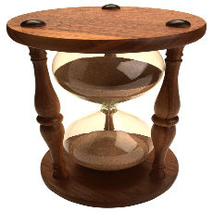
Your approach…
Let’s take about five more minutes and brainstorm what approach you will use?

Slide 37
Setting The Plan

Slide 38
Available resources
Common, horizontally aligned planning time in each content areas
One “expert” teacher in each content area
Data and video collected during the pilot team
A district position to free up coaching time
Previous initiatives in data analysis and professional learning communities that lacked direction or proper oversight

Slide 39
Careful approach
Each PLC has its own needs and its own collection of personalities
9th grade Science-poor collaboration
9th grade Social Studies-had “text-less classrooms”
9th grade Math-burdened with initiatives
9th grade English-A panacea of passive-aggression
It is important to LISTEN to their concerns and react accordingly

Slide 40
Profile the teachers involved in each PLC
Eager to try new ideas
Laid back
Resistant

Slide 41
Colquitt teachers
Different buildings, different needs
One building: tried a whole staff approach based on content
Second building: focus on targeted teachers
Most were open to experimentation
Some were struggling teachers

Slide 42
Your staff…
Let’s take five minutes and consider the staff in your core content areas.
Who is likely to embrace new practices?
Who is likely to work though a strategy until it works?
Who are likely to be the most resistant?
Which PLC or departments are fully independent? Who needs support? Who needs supervision?

Slide 43
Plotting the Course

Slide 44
Prioritizing the modules
It became clear that, unlike the pilot team the other teachers didn’t have the benefit of going through all of the trainings in short succession.
So we created a deliberate order for the modules:
1st sets purpose
selected modules based on ease of implementation
grouped before, during, and after reading strategies.

Slide 45
Module 1-Moving to 90 Minutes
Set the purpose
Established the research base
Was framed as a solution to a new problem

Slide 46
Module 2-PALS
Easy to implement
Replaces current reading practices easily
When done well, students see better comprehension almost immediately.

Slide 47
According to Zepeda*: Well designed PD
Extends over time
Has planned follow-up
Is job-embedded
Promotes reflection and inquiry
Includes multiple modalities
Is site-based and includes teachers from the same grade level and subject area
Is based on student performance data
*These points are all attributed to numerous other researchers, but she succinctly organizes it in her text.

Slide 48
Designing A Timeline: My District
The modules worked on a three week cycle.
Week 1: view module
Week 2: work the focus strategy into a lesson
Week 3: meet with coach and PLC to share results

Slide 49
The coaches role during weeks one and two of a cycle
Get into classrooms ASAP
Some teachers may challenge you
Focus on teachers who are reluctant, but will try when supported
Collect testimonials and work product
Offer assistance to any teacher who is unsuccessful in their first attempt

Slide 50
Advanced exposure
Introduce some of the strategies to certain staff members before the module though helping them design or redesign a whole lesson
This will help with producing better instruction and will allow you to produce new instructional support videos and build PLC support

Slide 51
Snowball effect
The more positive evidence of practice that you can generate at your school with your kids the easier the transition will be
The more lessons you help facilitate the better the student product will be
The better the student product, the easier it will be to sway others during data analysis in PLC

Slide 52
Timeline: GA Districts
Created a timeline based on trainings
PD day with consultant
Designed to create work product
Timeline to complete work product
For feedback
For teaching
For data collection
Follow-Up PD with consultant to discuss outcomes

Slide 53
Timeline: GA Districts
Not every deadline was firm
Generally, though:
The more the administration prioritized meeting deadlines, the better the schools did
Schools that were too soft or didn’t select staff well didn’t see training turn into practice
That said, being too hard can backfire

Slide 54
Your approach…
What is your timeline for implementation? How is the new teacher learning supported across the year?

Slide 55
According to Zepeda*: Well designed PD
Extends over time
Has planned follow-up
Is job-embedded
Promotes reflection and inquiry
Includes multiple modalities
Is site-based and includes teachers from the same grade level and subject area
Is based on student performance data
*These points are all attributed to numerous other researchers, but she succinctly organizes it in her text.

Slide 56
Collect work product at intervals
Teachers are busy. Make sure that there is some product that indicates that they attempted the practice
The best product is a new lesson plan or student work produced by implementing the strategy
The work product collection should support inquiry and growth, not compliance
REMEMBER: Effective PD is job-embedded

Slide 57
What can we analyze?
Teacher Product
Student Product
Lesson plans
Reflection statements
Benchmarking discussions
PLC notes
Recorded lessons
Lesson assessments for related lessons
School generated assessments
Standardized assessments
Student reflections

Slide 58
Data collection
My School
GA Schools
Formative
Lesson plans
With feedback notes
Student work from lessons
Video of lessons
With feedback notes
Teacher module notes and reflections
Summative
Reading Inventory
Common Assessments
Formative
Lesson plans
With feedback notes
Student work from lessons
Video of lessons
With feedback notes
Summative
Reading Inventory
State tests

Slide 59
Your approach…
What data are you collecting? How are you collecting it? I know you have a lot of data, but do you have the right data?

Slide 60
What does the data tell you about your program?
Sometimes programs are “judged” to be ineffective and scrapped. All too often such judgements are based on perceptions alone rather than on systematically collected evidence. (Zepeda, 2012)

Slide 61
A word about coaches

Slide 62
The coach
The coach exists between the administration and the teachers
The coach is seen more as an assistant than a tool of administration

Slide 63
Defining Coach
The coaches roles fall under a few categories:
Design, schedule, and implement PD
Lesson design
Teacher troubleshooting
PD monitoring
Facilitating PLC and data collection/discussion

Slide 64
Quid pro quo
The advantage of a coach is that they are positioned to provide assistance to everyone
A coach doesn’t roll-out a literacy plan: the coach helps teachers with initiative inquiry
A coach doesn’t evaluate teachers: they help a teacher evaluate a lesson’s product in PLC
A coach doesn’t give tell you what to teach: a coach helps design a lesson and helps teach it

Slide 65
Time to follow up
Our administrators already had too much to do on any given day
Observations and PLC monitoring frequently get moved to the wayside for more immediate concerns
The coach has time to be relevant PLC session to ensure progress

Slide 66
Most importantly…
The coach and the literacy initiative were:
Preparing the school for CCSS and Smarter Balanced Assessments
Simplifying LFS practices
Clarifying the purposes of data discussions and PLC
We were positioned as an asset to make everyone’s lives easier

Slide 67
Successful GA schools generally
Had one devoted stakeholder
Usually a coach
Spent time organizing subsequent trainings
Provided support for implementation issues
Collected data about performance

Slide 68
Questions?

Slide 69
With the time remaining…
Using the items we developed earlier, let’s continue to refine our PD plans for next year
Think about how what we discussed can be used to augment your current literacy plan

